Slide 1
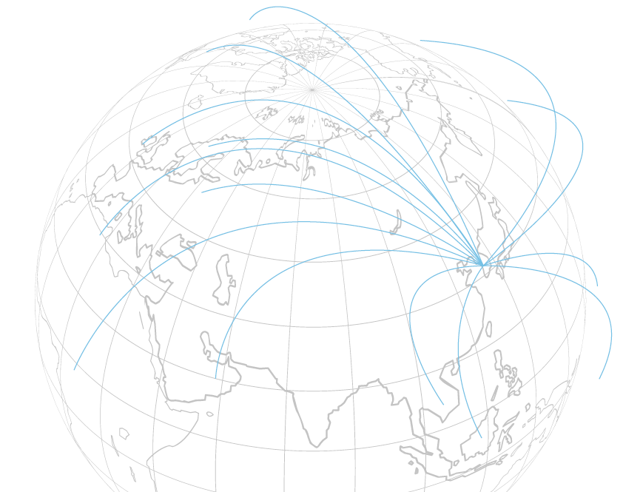


중국 SDV 표준화 전략과 API 구조 분석
China’s Software-Defined Vehicle Standardization and API Architecture Architecture Overview
Mobility Platform Research Center
Intelligent Information Research Division
AI Convergence R&D Laboratory
Korea Electronics Technology Institute
2025년08월
박부식 센터장
(pusik.park@keti.re.kr)

Slide 2

SDV 개요 및 중국 표준화 배경
Overview of SDV and Background of China’s Standardization
SDV 개념과 기존 차량 구조와의 차이
글로벌 표준화 동향 (AUTOSAR, SOAFEE, COVESA 등)
중국의 SDV 표준 추진 배경
중국 표준화 전략 개요

Slide 3
SDV 개념과 기존 차량 구조와의 차이
기존 차량 구조:
ECU(전자제어장치)마다 기능별 탑재 → 복잡한 네트워크 (CAN, LIN 등)
하드웨어 종속, 기능 확장·변경 어려움
SDV 구조:
차량 기능을 소프트웨어로 정의
Domain → Zonal → 중앙 HPC 구조로 진화
OTA 업데이트, SOA(Service-Oriented Architecture), AI·Cloud 연계
Notes:
This slide shows the C-ITS specification of Korea and Europe.
These old texts mean the solution KETI already has.
KETI is supporting several companies for their C-ITS business.
When they want to expand their business to Europe, KETI can support their business for example, inter-operability test in AstaZero.
(생략)
As I briefly mentioned earlier, for C-ITS, Korea is following the American approach for the Day 1.
However, in the Day 2 phase, it’s possible that everyone will unify under the 5G-V2X.
Fortunately, my center has C-ITS protocol software stack solution essentials for 5G-V2X and I’ll be able to assist small and medium-sized enterprises in their business efforts for C-ITS.

Slide 4
글로벌 표준화 동향 (AUTOSAR, SOAFEE, COVESA 등)
AUTOSAR (Classic / Adaptive): 차량 E/E 아키텍처와 기능 안전 중심 표준
SOAFEE (Arm 주도): 클라우드 네이티브 기반 SDV 소프트웨어 프레임워크
COVESA (Vehicle Signal Specification): 차량 신호·데이터 표준화 → 상호운용성 강화
Eclipse SDV: 오픈소스 생태계 구축, OEM 협력 확대
OPEN Alliance / MIPI / UNECE R155·R156: 차량 이더넷, 센서 인터페이스, 보안 규제
📌 시각화: 표 형태 → 표준 / 특징 / 주도 기관
Notes:
This slide shows the C-ITS specification of Korea and Europe.
These old texts mean the solution KETI already has.
KETI is supporting several companies for their C-ITS business.
When they want to expand their business to Europe, KETI can support their business for example, inter-operability test in AstaZero.
(생략)
As I briefly mentioned earlier, for C-ITS, Korea is following the American approach for the Day 1.
However, in the Day 2 phase, it’s possible that everyone will unify under the 5G-V2X.
Fortunately, my center has C-ITS protocol software stack solution essentials for 5G-V2X and I’ll be able to assist small and medium-sized enterprises in their business efforts for C-ITS.

Slide 5
중국의 SDV 표준 추진 배경
기술 자립: 해외 AUTOSAR 의존 탈피, 독자 플랫폼 구축
디지털 주권 확보: 반도체–소프트웨어 수직통합 전략
산업 연계: EV → SDV → 스마트시티 확장 모델
정책 드라이브: MIIT(공신부), CATARC, CCSA 주도 국가 차원의 표준화 프로젝트
📌 시각화: 중국 정부 → 표준기관(CCSA) → OEM·ICT 기업 협력 네트워크
Notes:
This slide shows the C-ITS specification of Korea and Europe.
These old texts mean the solution KETI already has.
KETI is supporting several companies for their C-ITS business.
When they want to expand their business to Europe, KETI can support their business for example, inter-operability test in AstaZero.
(생략)
As I briefly mentioned earlier, for C-ITS, Korea is following the American approach for the Day 1.
However, in the Day 2 phase, it’s possible that everyone will unify under the 5G-V2X.
Fortunately, my center has C-ITS protocol software stack solution essentials for 5G-V2X and I’ll be able to assist small and medium-sized enterprises in their business efforts for C-ITS.

Slide 6
중국 표준화 전략 개요
표준 체계:
Part 1 (Atomic Service API): 차량 서비스 기능을 도메인 단위 API로 정의
Part 2 (Device Abstraction API): 하드웨어 추상화 계층 → 서비스 API와 연계
전략적 방향:
개방형·서비스 지향 아키텍처
국제표준(AUTOSAR 등) 대비 빠른 적용·확장성
중국 독자 생태계 구축 및 국제 영향력 확대
📌 시각화:
Atomic API ↔ Device API 계층 구조도
“Service Layer – Abstraction Layer – Hardware” 흐름 다이어그램
Notes:
This slide shows the C-ITS specification of Korea and Europe.
These old texts mean the solution KETI already has.
KETI is supporting several companies for their C-ITS business.
When they want to expand their business to Europe, KETI can support their business for example, inter-operability test in AstaZero.
(생략)
As I briefly mentioned earlier, for C-ITS, Korea is following the American approach for the Day 1.
However, in the Day 2 phase, it’s possible that everyone will unify under the 5G-V2X.
Fortunately, my center has C-ITS protocol software stack solution essentials for 5G-V2X and I’ll be able to assist small and medium-sized enterprises in their business efforts for C-ITS.

Slide 7
중국 SDV API 표준 분석
Atomic Service API (Part 1)
Atomic API 개요 및 설계 철학
서비스 도메인 분류 체계 (24개 도메인)
주요 서비스 예시 (예: Power, IVI, TSP 등)
메시지 구조와 호출 방식
특징 및 제약 사항

Slide 8
Atomic API 개요 및 설계 철학
정의: Atomic Service API = 차량 기능을 최소 단위 서비스로 정의한 인터페이스
설계 철학:
서비스 지향 아키텍처(SOA) 기반
기능 단위(Service, Event, Method, Field) 분리
API 계층적 구조(서비스 ↔ 메서드 ↔ 파라미터 ↔ 필드)
목적: 하드웨어 독립적·재사용 가능한 API 제공
📌 시각화: Atomic API 5계층 구조도 (Service → Method → Parameter → Field → Interface)
Notes:
This slide shows the C-ITS specification of Korea and Europe.
These old texts mean the solution KETI already has.
KETI is supporting several companies for their C-ITS business.
When they want to expand their business to Europe, KETI can support their business for example, inter-operability test in AstaZero.
(생략)
As I briefly mentioned earlier, for C-ITS, Korea is following the American approach for the Day 1.
However, in the Day 2 phase, it’s possible that everyone will unify under the 5G-V2X.
Fortunately, my center has C-ITS protocol software stack solution essentials for 5G-V2X and I’ll be able to assist small and medium-sized enterprises in their business efforts for C-ITS.
This slide shows the C-ITS specification of Korea and Europe.
These old texts mean the solution KETI already has.
KETI is supporting several companies for their C-ITS business.
When they want to expand their business to Europe, KETI can support their business for example, inter-operability test in AstaZero.
(생략)
As I briefly mentioned earlier, for C-ITS, Korea is following the American approach for the Day 1.
However, in the Day 2 phase, it’s possible that everyone will unify under the 5G-V2X.
Fortunately, my center has C-ITS protocol software stack solution essentials for 5G-V2X and I’ll be able to assist small and medium-sized enterprises in their business efforts for C-ITS.

Slide 9
서비스 도메인 분류 체계 (24 Domains)
총 24개 서비스 도메인 정의
주요 그룹:
Vehicle Body: Power, Door/Window, Lighting, Seat
Infotainment & TSP: IVI, Navigation, Telematics
Chassis & Driving: Driving Assistance, Sensor Access
Energy: Battery & Energy Management
Connectivity & Security: V2X, Authentication
도메인별 API 묶음을 통해 상위 애플리케이션 개발 가능
📌 시각화: 원형 다이어그램(24개 카테고리) 또는 트리맵
Notes:
This slide shows the C-ITS specification of Korea and Europe.
These old texts mean the solution KETI already has.
KETI is supporting several companies for their C-ITS business.
When they want to expand their business to Europe, KETI can support their business for example, inter-operability test in AstaZero.
(생략)
As I briefly mentioned earlier, for C-ITS, Korea is following the American approach for the Day 1.
However, in the Day 2 phase, it’s possible that everyone will unify under the 5G-V2X.
Fortunately, my center has C-ITS protocol software stack solution essentials for 5G-V2X and I’ll be able to assist small and medium-sized enterprises in their business efforts for C-ITS.
This slide shows the C-ITS specification of Korea and Europe.
These old texts mean the solution KETI already has.
KETI is supporting several companies for their C-ITS business.
When they want to expand their business to Europe, KETI can support their business for example, inter-operability test in AstaZero.
(생략)
As I briefly mentioned earlier, for C-ITS, Korea is following the American approach for the Day 1.
However, in the Day 2 phase, it’s possible that everyone will unify under the 5G-V2X.
Fortunately, my center has C-ITS protocol software stack solution essentials for 5G-V2X and I’ll be able to assist small and medium-sized enterprises in their business efforts for C-ITS.
This slide shows the C-ITS specification of Korea and Europe.
These old texts mean the solution KETI already has.
KETI is supporting several companies for their C-ITS business.
When they want to expand their business to Europe, KETI can support their business for example, inter-operability test in AstaZero.
(생략)
As I briefly mentioned earlier, for C-ITS, Korea is following the American approach for the Day 1.
However, in the Day 2 phase, it’s possible that everyone will unify under the 5G-V2X.
Fortunately, my center has C-ITS protocol software stack solution essentials for 5G-V2X and I’ll be able to assist small and medium-sized enterprises in their business efforts for C-ITS.
This slide shows the C-ITS specification of Korea and Europe.
These old texts mean the solution KETI already has.
KETI is supporting several companies for their C-ITS business.
When they want to expand their business to Europe, KETI can support their business for example, inter-operability test in AstaZero.
(생략)
As I briefly mentioned earlier, for C-ITS, Korea is following the American approach for the Day 1.
However, in the Day 2 phase, it’s possible that everyone will unify under the 5G-V2X.
Fortunately, my center has C-ITS protocol software stack solution essentials for 5G-V2X and I’ll be able to assist small and medium-sized enterprises in their business efforts for C-ITS.

Slide 10
주요 서비스 예시 (Power, IVI, TSP)
예시 1: Power System Service
Method: getPowerStatus(), setPowerMode()
Field: Battery level, Charging status
예시 2: IVI (In-Vehicle Infotainment)
Method: playMedia(), setVolume()
Event: Status change notification
예시 3: TSP (Telematics Service Provider)
Method: remoteUnlock(), vehicleLocate()
Event: Emergency call trigger
📌 시각화: 각 서비스별 블록 + API 예시 JSON snippet
Notes:
This slide shows the C-ITS specification of Korea and Europe.
These old texts mean the solution KETI already has.
KETI is supporting several companies for their C-ITS business.
When they want to expand their business to Europe, KETI can support their business for example, inter-operability test in AstaZero.
(생략)
As I briefly mentioned earlier, for C-ITS, Korea is following the American approach for the Day 1.
However, in the Day 2 phase, it’s possible that everyone will unify under the 5G-V2X.
Fortunately, my center has C-ITS protocol software stack solution essentials for 5G-V2X and I’ll be able to assist small and medium-sized enterprises in their business efforts for C-ITS.
This slide shows the C-ITS specification of Korea and Europe.
These old texts mean the solution KETI already has.
KETI is supporting several companies for their C-ITS business.
When they want to expand their business to Europe, KETI can support their business for example, inter-operability test in AstaZero.
(생략)
As I briefly mentioned earlier, for C-ITS, Korea is following the American approach for the Day 1.
However, in the Day 2 phase, it’s possible that everyone will unify under the 5G-V2X.
Fortunately, my center has C-ITS protocol software stack solution essentials for 5G-V2X and I’ll be able to assist small and medium-sized enterprises in their business efforts for C-ITS.

Slide 11
메시지 구조와 호출 방식, 특징·제약 사항
메시지 구조:
JSON 기반 key-value
Request/Response, Event-driven 지원
serviceId, method, params, result 구조
호출 방식:
동기(Sync) + 비동기(Async) 지원
QoS 정책 적용 (예: 최대 응답 시간)
특징 및 제약:
특징: 표준화된 인터페이스, 서비스 재사용성, SOA 친화적
제약:
성능 오버헤드 가능
일부 하드웨어 특화 기능은 추상화 어려움
API 호출 주기 제한 있음 (예: 1초 이내 반복 호출 금지)
📌 시각화: Request–Response 흐름도
Notes:
This slide shows the C-ITS specification of Korea and Europe.
These old texts mean the solution KETI already has.
KETI is supporting several companies for their C-ITS business.
When they want to expand their business to Europe, KETI can support their business for example, inter-operability test in AstaZero.
(생략)
As I briefly mentioned earlier, for C-ITS, Korea is following the American approach for the Day 1.
However, in the Day 2 phase, it’s possible that everyone will unify under the 5G-V2X.
Fortunately, my center has C-ITS protocol software stack solution essentials for 5G-V2X and I’ll be able to assist small and medium-sized enterprises in their business efforts for C-ITS.
This slide shows the C-ITS specification of Korea and Europe.
These old texts mean the solution KETI already has.
KETI is supporting several companies for their C-ITS business.
When they want to expand their business to Europe, KETI can support their business for example, inter-operability test in AstaZero.
(생략)
As I briefly mentioned earlier, for C-ITS, Korea is following the American approach for the Day 1.
However, in the Day 2 phase, it’s possible that everyone will unify under the 5G-V2X.
Fortunately, my center has C-ITS protocol software stack solution essentials for 5G-V2X and I’ll be able to assist small and medium-sized enterprises in their business efforts for C-ITS.

Slide 12
중국 SDV API 표준 분석
Device Abstraction API (Part 2)
Device API 개요와 설계 목적
계층 구조 (ECU → Abstract Device → Service)
데이터 모델과 메시지 정의 방식
도메인별 인터페이스 사례
Atomic API와의 연동 및 시사점

Slide 13
Device API 개요와 설계 목적
정의: 하드웨어 장치(센서, 액추에이터 등)를 추상화하여 상위 서비스(API)와 연결하는 인터페이스
설계 목적:
하드웨어와 서비스 로직의 분리
이기종 ECU·장치 간 통합 인터페이스 제공
재사용성 및 플랫폼 독립성 확보
역할: Atomic Service API가 차량 기능(Service)을 정의하면, Device API는 이를 실제 장치에 매핑
📌 시각화: Service ↔ Device API ↔ Hardware 흐름 다이어그램
Notes:
This slide shows the C-ITS specification of Korea and Europe.
These old texts mean the solution KETI already has.
KETI is supporting several companies for their C-ITS business.
When they want to expand their business to Europe, KETI can support their business for example, inter-operability test in AstaZero.
(생략)
As I briefly mentioned earlier, for C-ITS, Korea is following the American approach for the Day 1.
However, in the Day 2 phase, it’s possible that everyone will unify under the 5G-V2X.
Fortunately, my center has C-ITS protocol software stack solution essentials for 5G-V2X and I’ll be able to assist small and medium-sized enterprises in their business efforts for C-ITS.

Slide 14
계층 구조 (ECU → Abstract Device → Service)
구성 계층:
ECU / Sensor / Actuator (물리 장치)
Abstract Device API (표준화된 인터페이스)
Service Layer (상위 애플리케이션)
특징:
각 ECU 기능을 추상화 객체로 정의
Service API가 Abstract Device를 호출 → 하드웨어 제어
📌 시각화:
[ Service Layer ]
↓
[ Abstract Device API ]
↓
[ ECU / Sensor / Actuator ]
Notes:
This slide shows the C-ITS specification of Korea and Europe.
These old texts mean the solution KETI already has.
KETI is supporting several companies for their C-ITS business.
When they want to expand their business to Europe, KETI can support their business for example, inter-operability test in AstaZero.
(생략)
As I briefly mentioned earlier, for C-ITS, Korea is following the American approach for the Day 1.
However, in the Day 2 phase, it’s possible that everyone will unify under the 5G-V2X.
Fortunately, my center has C-ITS protocol software stack solution essentials for 5G-V2X and I’ll be able to assist small and medium-sized enterprises in their business efforts for C-ITS.
This slide shows the C-ITS specification of Korea and Europe.
These old texts mean the solution KETI already has.
KETI is supporting several companies for their C-ITS business.
When they want to expand their business to Europe, KETI can support their business for example, inter-operability test in AstaZero.
(생략)
As I briefly mentioned earlier, for C-ITS, Korea is following the American approach for the Day 1.
However, in the Day 2 phase, it’s possible that everyone will unify under the 5G-V2X.
Fortunately, my center has C-ITS protocol software stack solution essentials for 5G-V2X and I’ll be able to assist small and medium-sized enterprises in their business efforts for C-ITS.

Slide 15
데이터 모델과 메시지 정의 방식
메시지 형식: JSON 기반 Key-Value 구조
구성 요소:
deviceId : 장치 식별자
interface : 추상화된 기능 (e.g., read, write)
params : 입력/출력 파라미터
result : 수행 결과 및 상태 코드
특징:
Event-driven + Request/Response 지원
QoS, Timeout 등 제약조건 포함
📌 시각화: JSON 예시 코드 블록
Notes:
This slide shows the C-ITS specification of Korea and Europe.
These old texts mean the solution KETI already has.
KETI is supporting several companies for their C-ITS business.
When they want to expand their business to Europe, KETI can support their business for example, inter-operability test in AstaZero.
(생략)
As I briefly mentioned earlier, for C-ITS, Korea is following the American approach for the Day 1.
However, in the Day 2 phase, it’s possible that everyone will unify under the 5G-V2X.
Fortunately, my center has C-ITS protocol software stack solution essentials for 5G-V2X and I’ll be able to assist small and medium-sized enterprises in their business efforts for C-ITS.

Slide 16
도메인별 인터페이스 사례 & Atomic API 연동 시사점
도메인별 인터페이스 사례:
Sensor Domain:
API: readSensorData(deviceId) → 데이터 반환
Power Domain:
API: setPowerState(deviceId, mode)
IVI Domain:
API: playAudio(deviceId, source)
Atomic API 연동 시사점:
Atomic API = “무엇을 할 것인가” (서비스 단위 정의)
Device API = “어떻게 실행할 것인가” (하드웨어 실행 계층)
두 계층 연동으로 서비스-장치 통합 구조 완성
📌 시각화: Atomic API ↔ Device API ↔ Hardware 매핑 그림
Notes:
This slide shows the C-ITS specification of Korea and Europe.
These old texts mean the solution KETI already has.
KETI is supporting several companies for their C-ITS business.
When they want to expand their business to Europe, KETI can support their business for example, inter-operability test in AstaZero.
(생략)
As I briefly mentioned earlier, for C-ITS, Korea is following the American approach for the Day 1.
However, in the Day 2 phase, it’s possible that everyone will unify under the 5G-V2X.
Fortunately, my center has C-ITS protocol software stack solution essentials for 5G-V2X and I’ll be able to assist small and medium-sized enterprises in their business efforts for C-ITS.

Slide 17
종합 분석 및 시사점
Comprehensive Analysis and Implications
중국 표준의 의의 (독자 생태계, 기술 자립)
AUTOSAR 등 기존 표준과 비교 분석
중국 표준의 장단점 평가
한국 자동차 산업에 주는 시사점
종합 정리 및 Q&A

Slide 18
중국 표준의 의의: 독자 생태계 & 기술 자립
서비스 지향(SOA)·개방형 API로 상위 애플리케이션을 빠르게 이식·확장
Device Abstraction으로 하드웨어(ECU/센서/액추에이터) 의존도 완화 → 부품 다변화·국산화 유리
국가 주도 표준화(기관·산업 연계)로 테스트·적합성 체계 동반 구축
EV → SDV → 스마트시티로 이어지는 산업 연계 시너지(데이터·연결성 중심)
Notes:
This slide shows the C-ITS specification of Korea and Europe.
These old texts mean the solution KETI already has.
KETI is supporting several companies for their C-ITS business.
When they want to expand their business to Europe, KETI can support their business for example, inter-operability test in AstaZero.
(생략)
As I briefly mentioned earlier, for C-ITS, Korea is following the American approach for the Day 1.
However, in the Day 2 phase, it’s possible that everyone will unify under the 5G-V2X.
Fortunately, my center has C-ITS protocol software stack solution essentials for 5G-V2X and I’ll be able to assist small and medium-sized enterprises in their business efforts for C-ITS.

Slide 19
AUTOSAR 등 기존 표준과 비교 분석
구분 중국 SDV API (Atomic/Device) AUTOSAR (Classic/Adaptive) COVESA VSS / Eclipse SDV
초점 서비스/장치 API 표준 E/E 아키텍처·SW 플랫폼 신호/데이터 모델, 오픈소스 생태계
단위 Service / Method / Event / Field SWC, RTE, POSIX 기반 Adaptive Vehicle Signal, 데이터 스키마
목표 신속한 서비스 개발·배포, HW 추상화 기능안전·품질·통합 프레임워크 상호운용 데이터 계층
거버넌스 국가·산업 주도 글로벌 컨소시엄 오픈 커뮤니티 중심
요지: 중국 표준은 API 인터페이스/추상화에 초점, AUTOSAR는 플랫폼·안전 체계, VSS는 데이터 통일에 강점. 상호보완 가능성 높음
.
Notes:
This slide shows the C-ITS specification of Korea and Europe.
These old texts mean the solution KETI already has.
KETI is supporting several companies for their C-ITS business.
When they want to expand their business to Europe, KETI can support their business for example, inter-operability test in AstaZero.
(생략)
As I briefly mentioned earlier, for C-ITS, Korea is following the American approach for the Day 1.
However, in the Day 2 phase, it’s possible that everyone will unify under the 5G-V2X.
Fortunately, my center has C-ITS protocol software stack solution essentials for 5G-V2X and I’ll be able to assist small and medium-sized enterprises in their business efforts for C-ITS.

Slide 20
중국 표준의 장단점 평가
장점
서비스·장치 계층 분리로 재사용성/확장성↑, 공급망 유연성↑
도메인 분류·표준 인터페이스로 이기종 시스템 통합 비용 절감
국가 차원 실증·보급 드라이브 → 적용 속도 기대
단점/리스크
국제 표준과의 호환성·중복 이슈(이중 유지 비용)
API 계층화에 따른 성능 오버헤드, 실시간성 검증 필요
보안·인증·QoS 운영 규칙의 성숙도·도구 체인 미성숙 가능성
OEM별 프로파일 분화 시 단일 표준의 파편화 우려
Notes:
This slide shows the C-ITS specification of Korea and Europe.
These old texts mean the solution KETI already has.
KETI is supporting several companies for their C-ITS business.
When they want to expand their business to Europe, KETI can support their business for example, inter-operability test in AstaZero.
(생략)
As I briefly mentioned earlier, for C-ITS, Korea is following the American approach for the Day 1.
However, in the Day 2 phase, it’s possible that everyone will unify under the 5G-V2X.
Fortunately, my center has C-ITS protocol software stack solution essentials for 5G-V2X and I’ll be able to assist small and medium-sized enterprises in their business efforts for C-ITS.

Slide 21
한국 자동차 산업에 주는 시사점
매핑 전략: COVESA VSS ↔ Atomic API ↔ Device API 간 매핑 가이드 마련(국내 공통 프로파일)
IVN/TSN 기반 실시간 제약 반영: 메시지 주기·QoS·우선순위(PCP) 표준 파라미터화
국산 부품 연계: 국산 ECU/센서에 대한 Device Abstraction 적합성 프로파일 정의(시험 항목 포함)
보안·OTA 통합 규격: R155/156, SBOM·SCA, 키관리·리모트 업데이트 정책을 API 정책과 연동
시험/실증 체계: 국내 적합성·상호운용 시험베드(레퍼런스 차량/게이트웨이) 구축 → 공급망 단위 검증
Notes:
This slide shows the C-ITS specification of Korea and Europe.
These old texts mean the solution KETI already has.
KETI is supporting several companies for their C-ITS business.
When they want to expand their business to Europe, KETI can support their business for example, inter-operability test in AstaZero.
(생략)
As I briefly mentioned earlier, for C-ITS, Korea is following the American approach for the Day 1.
However, in the Day 2 phase, it’s possible that everyone will unify under the 5G-V2X.
Fortunately, my center has C-ITS protocol software stack solution essentials for 5G-V2X and I’ll be able to assist small and medium-sized enterprises in their business efforts for C-ITS.

Slide 22
종합 정리 & Q&A
중국 표준의 핵심: 서비스 API + 장치 추상화로 빠른 서비스 전개와 HW 독립성 확보
AUTOSAR/VSS 등과의 상호보완적 활용이 현실적 전략
한국은 매핑 가이드·프로파일·테스트베드 3종 세트를 선제 구축 필요
Next Step: (1) 우선 도메인 선정(예: 파워/IVI/센서), (2) 국내 프로파일 초안, (3) PoC 차량 실증
참고 근거: 초기 SDV 개념·배경 및 중국 추진 맥락 요약
, 중국 표준(Atomic/Device) 구조·철학 및 글로벌 표준 언급
.
Notes:
This slide shows the C-ITS specification of Korea and Europe.
These old texts mean the solution KETI already has.
KETI is supporting several companies for their C-ITS business.
When they want to expand their business to Europe, KETI can support their business for example, inter-operability test in AstaZero.
(생략)
As I briefly mentioned earlier, for C-ITS, Korea is following the American approach for the Day 1.
However, in the Day 2 phase, it’s possible that everyone will unify under the 5G-V2X.
Fortunately, my center has C-ITS protocol software stack solution essentials for 5G-V2X and I’ll be able to assist small and medium-sized enterprises in their business efforts for C-ITS.

Slide 23


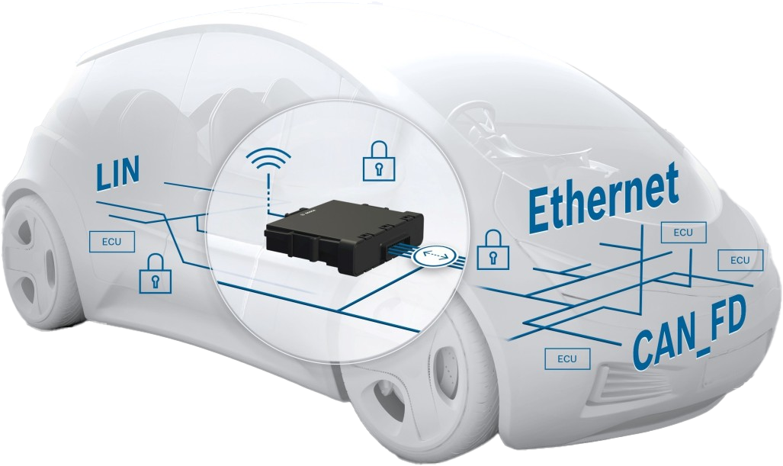
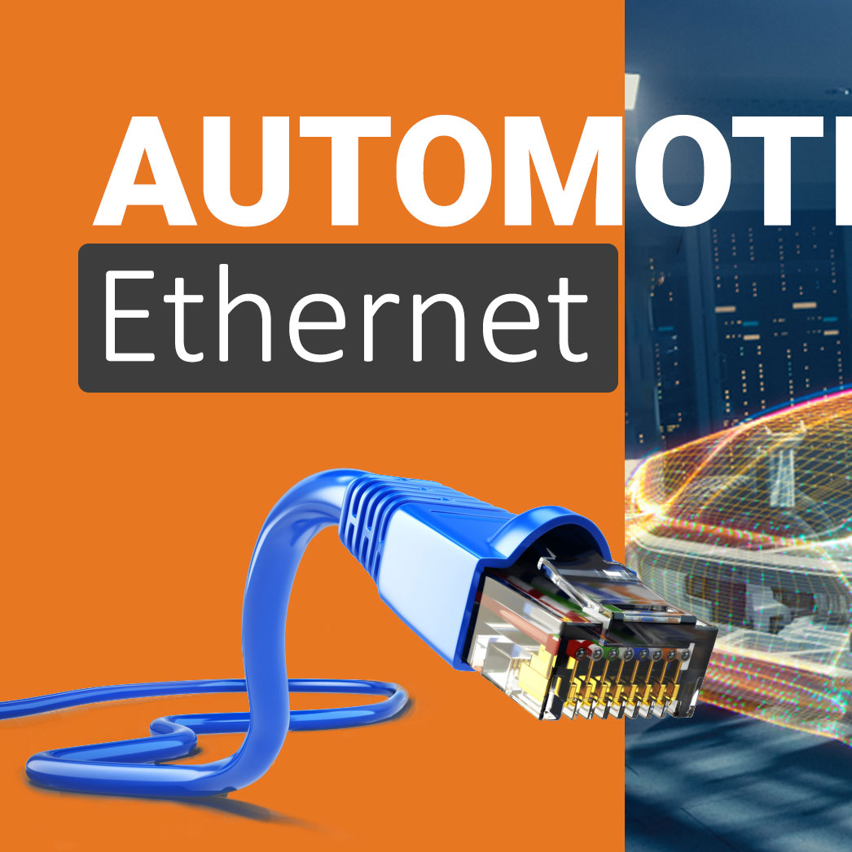



Software-Defined Vehicle Solutions
Time Sensitive Network
1
Software-Defined Vehicle
3
Avionics Full-Duplex Ethernet Switched Ethernet (AFDX)
Precise Time Protocol (PTP)
Single Pair Ethernet (SPE)
Physical Layer Collision Avoidance (PLCA)
Automotive Ethernet
Robust, Scalable and Secure SW architecture
Over-the-Air (OTA) Updates
Vehicle-to-Everything Communication
Data Management and Analytics
Computing, Edge and Cloud
Cybersecurity
Middleware
2
All Ethernet Vehicle
4
AUTOSAR Classic
AUTOSAR Adaptive
Scalable service-Oriented MiddlewarE over IP (SOME/IP)
Simple Network Management Protocol (SNMP)
Universal Plug and Play
Zonal E/E Architecture
10BASE-T1S, 10BASE-T1L
10G Ethernet Backbone
Ultra-Low Latency Comm.
Power Over Ethernet (PoE)
Safety & Security
Zero-Configuration Network
Reconfiguration
Notes:
Software-defined vehicle is currently a hot topic in the automotive industry.
I’ve had discussion with Hyundai representatives about this, but it seems that no OEM has yet decided 100% on how to develop a Software-defined vehicle – Tesla is the notable exception.
Now, several big pictures are decided like zonal e/e architecture.
Based on KETI’s experience of In-Vehicle Network project, All-Ethernet Vehicle is my recent interest.
I thought that I’d make my presentation as brief as possible.
I’m really looking forward to the introduction of RISE.
After coffee-break.
That’s it.
Think you for your listening.

